Slide 1
ORS STEM Committee Agenda
January 18, 2022
Guest Speaker: Dr. Mark Buckner discusses the new i-School program at ORHS
Committee Discussion: What are your “walls”?
School STEM Share-Out
Community Partner Share-Out

Slide 2
Committee Norms
We will maintain a positive tone at our meetings.
We will remain solutions-oriented at our meetings.
We will begin and end our meetings on time and stay fully engaged
throughout each meeting.
We will listen respectfully and consider matters from another’s
perspective.

Slide 3
Guest Speaker:
Dr. Mark Buckner
ORHS CCTE and i-school Instructor mabuckner@ortn.edu

Slide 4

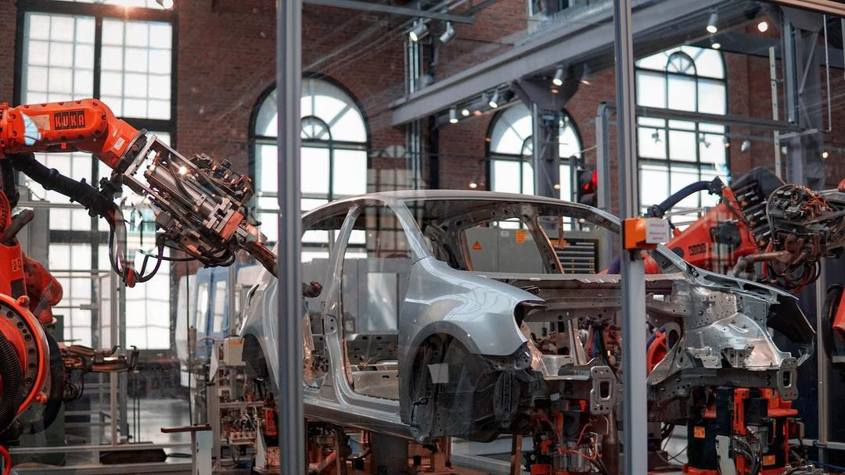




i-School
An Innovation Learning Ecosystem
b y D r . H o l l y C r o s s & D r . M a r k B u c k n e r
empowering the InnovatORS of tomorrow today!
innovation, individualized, inclusion, interpersonal, integrative- thinking, interdisciplinary, always improving and internal motivation

Slide 5

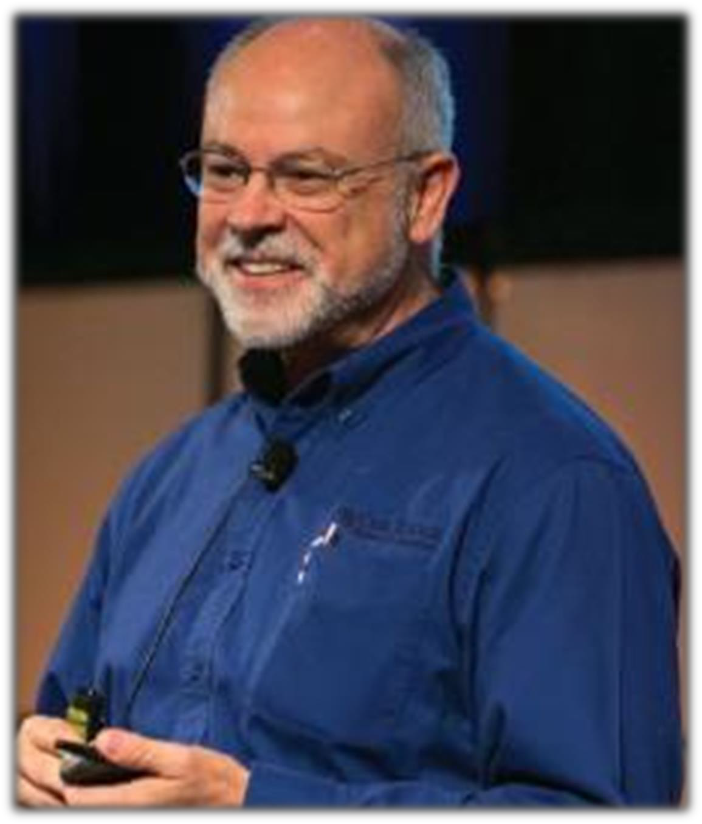


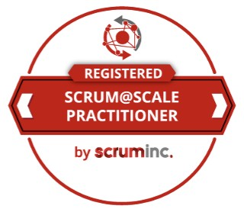

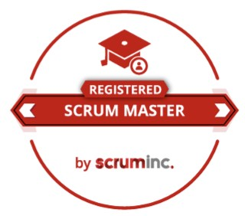
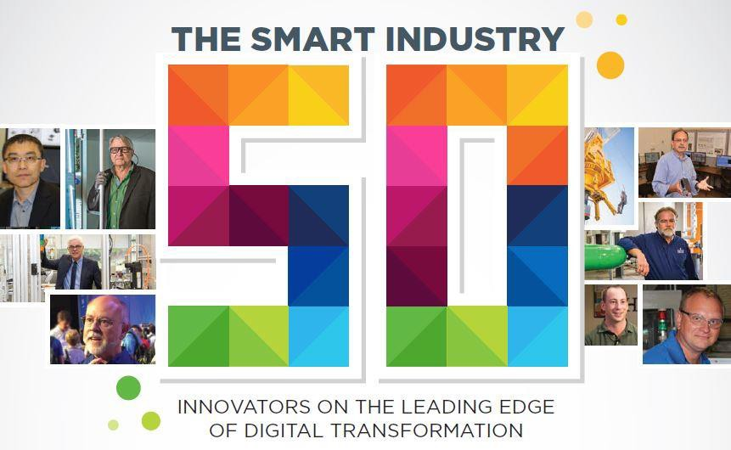
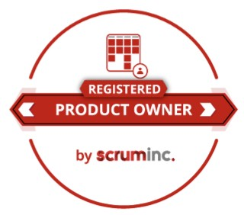
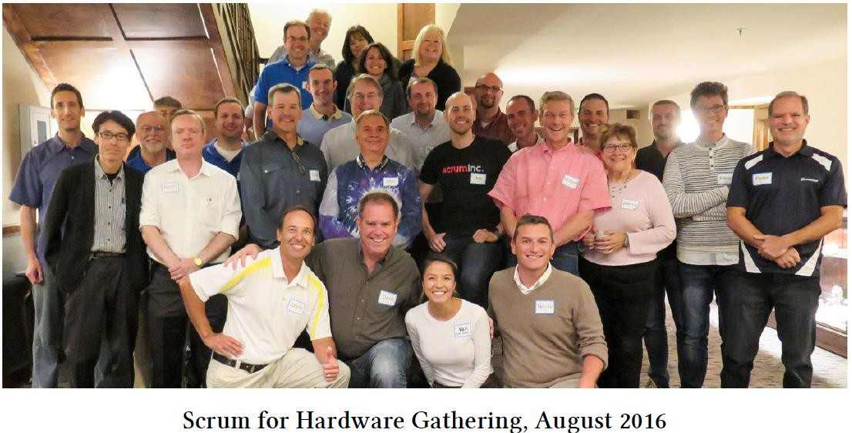
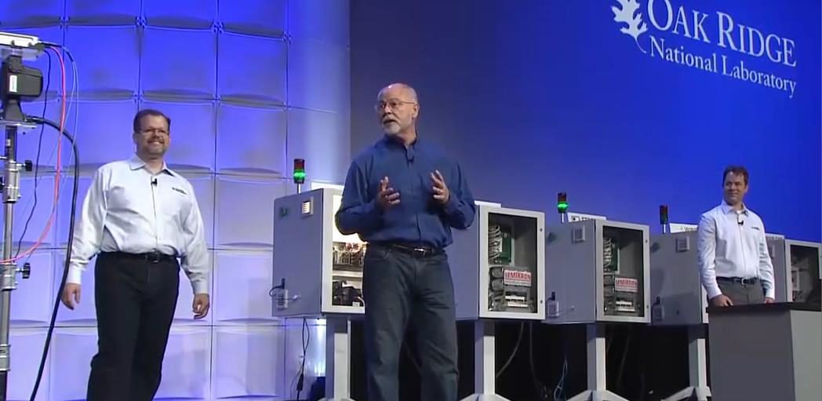
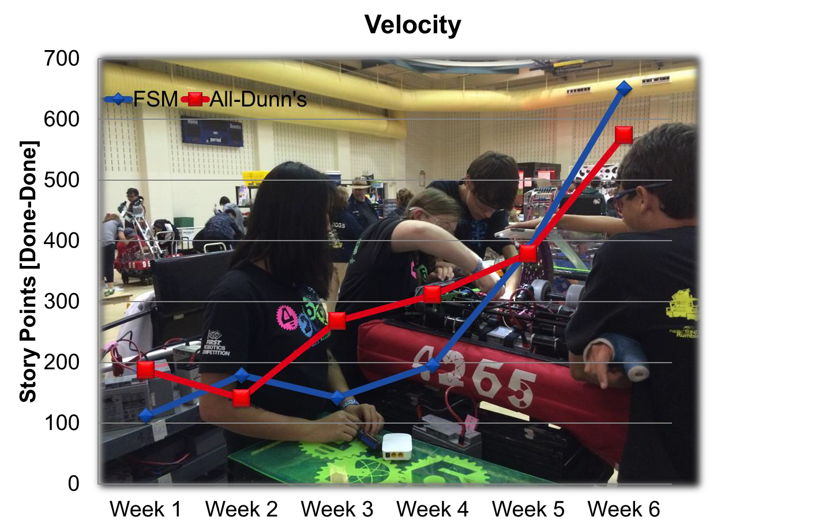
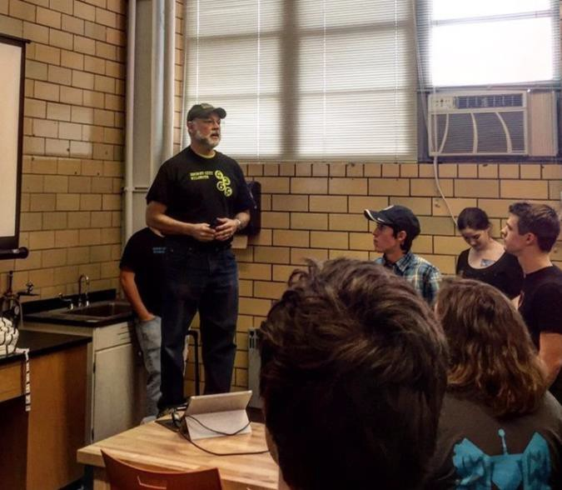
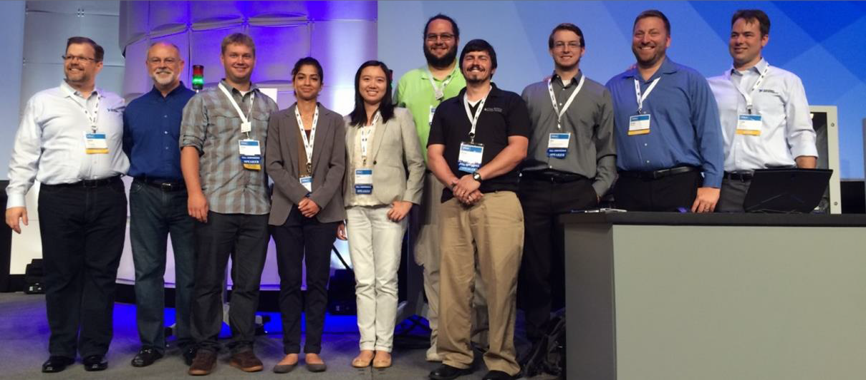
Mark Buckner, Ph.D.
ORHS i-School Lead Instructor
Enterprise Agile Transformation Consultant, Trainer, Coach @Scrum
Inc.
Distinguished Research Scientist, Power & Energy Systems Group Leader, Scrum Coach @ Oak Ridge National Laboratory – 32+ years.
FIRST Robotics Lead Mentor and Scrum Coach – 4265 Secret City Wildbots.
BA: Physics, Psychology; MS: Nuclear Engineering; PhD: Applied Artificial Intelligence.
Adjunct Faculty: Oak Ridge High School, Roane State Community College, University of Tennessee
2016 Smart Industry 50: Innovators at the leading edge of digital transformation

Slide 6
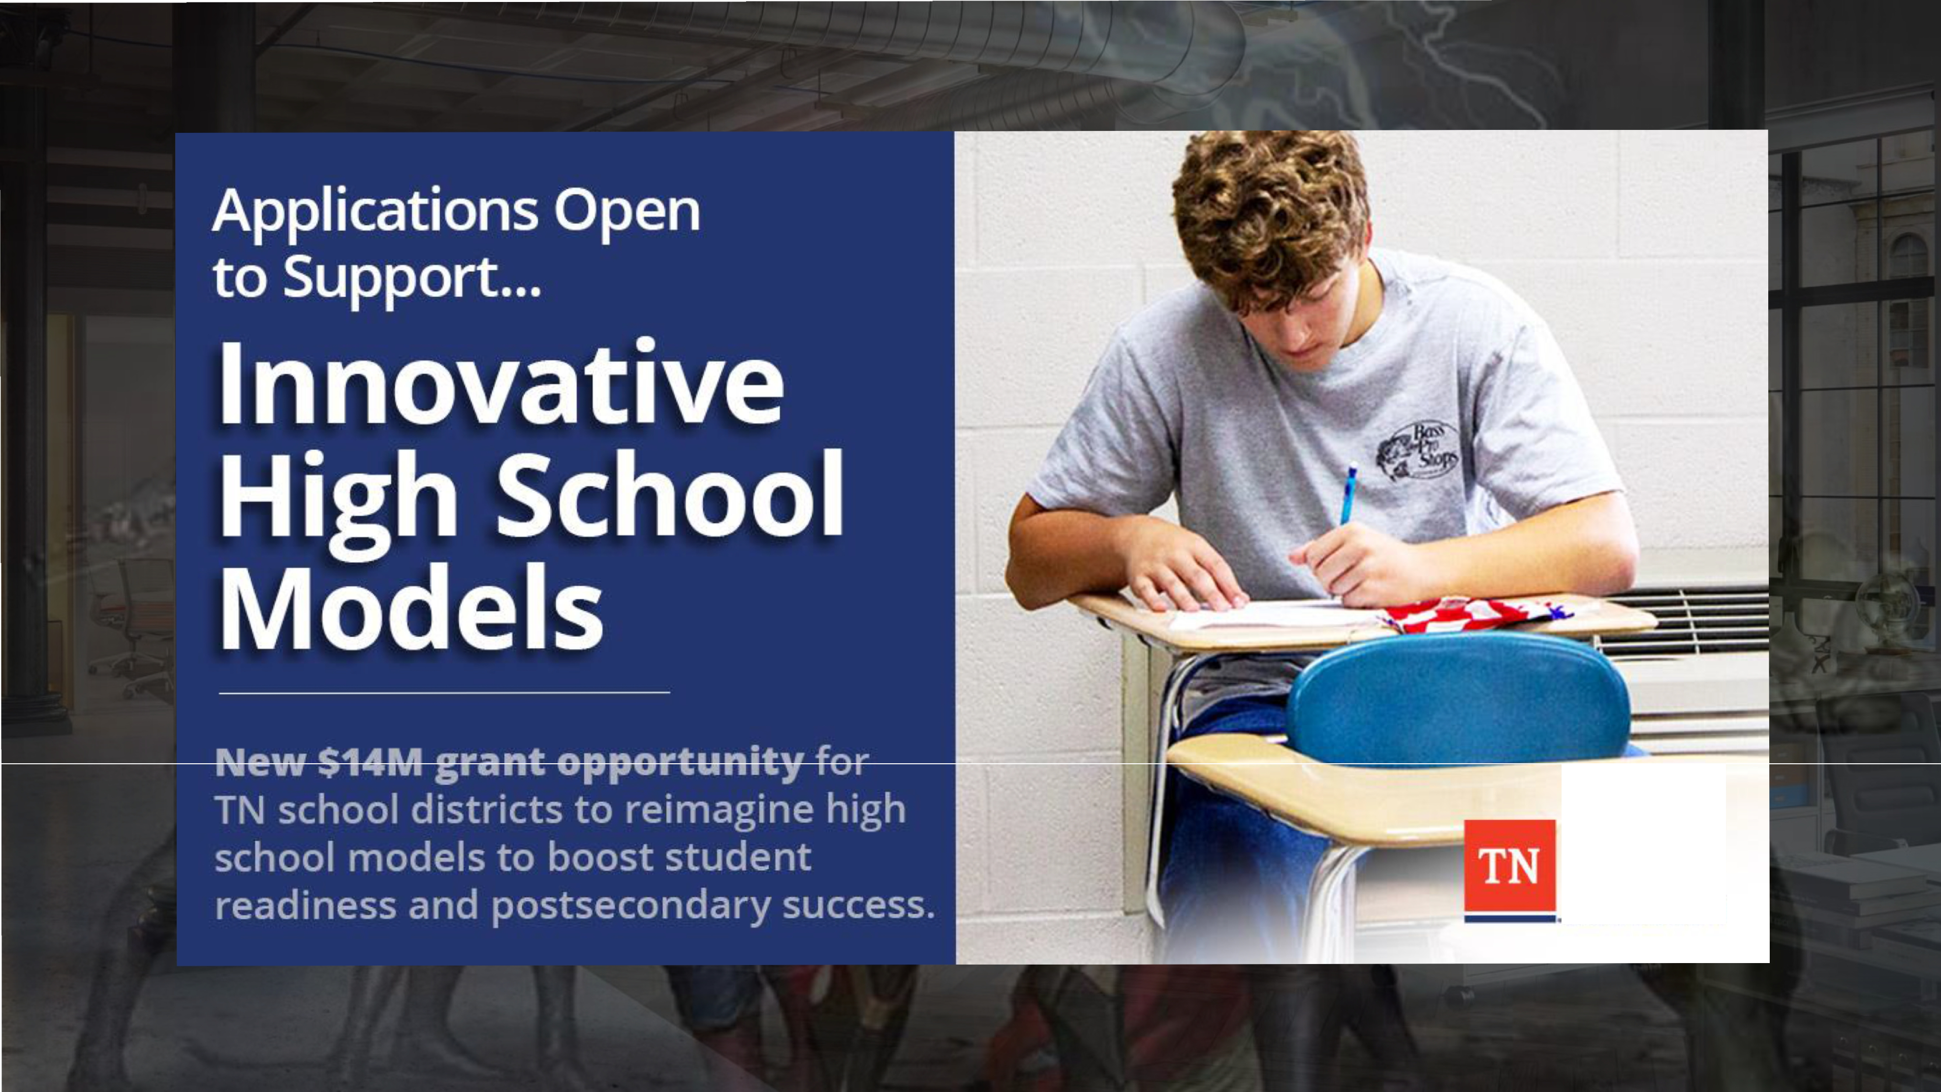
Departmen of
--Educa ·on

Slide 7
TDOE grant review team has stated the below are the standards to which we are to align. But this is the floor.
Level I i-School STEM Foundations
Safety
Stem Fields Exploration
Problem Resolution Skills
Critical Thinking in Context
STEM Field Readiness
Cause and Effect Relationships in STEM
Level III – i-School STEM in Context
Safety
Essential Components of STEM Research
Research and Project Definition
Team Development
Communication
Project Management
Project Completion and Presentation
Evaluation of Project Outcome
Level II i-School Applications
The Roles of Scientists and Engineers
Questioning and Defining Problems
Modeling
Planning and Investigating
Data Analysis and Interpretation
Problem Solutions and Scientific
Explanations
Communicating Solutions and Explanations
Level IV – i-School Practicum/Site-Based Enterprise
Safety
STEM Employment Research and Preparation
Ethics
Transferring Course Concepts to Practicum/Site-Based
Enterprise
Portfolio

Slide 8



Time is Accelerating
“In order to keep up with the world of
2050, you will need not merely to invent new ideas and products – you will above all need to reinvent yourself again and again.”
— Yuval Noah Harari
source: WIRED -- Yuval Noah Harari on what the year 2050 has in store for humankind

Slide 9
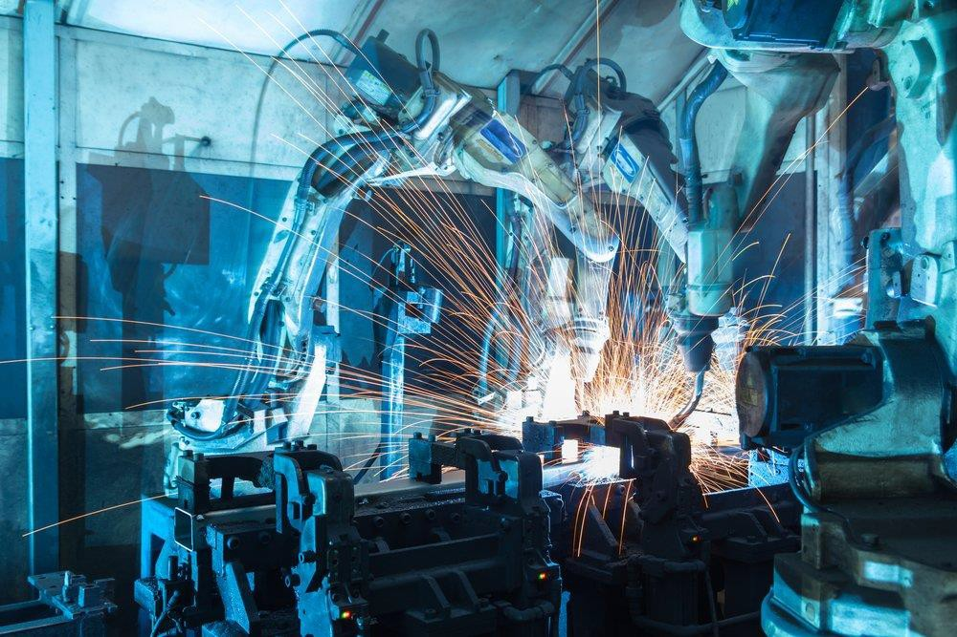

Exponential Growth Technologies
Sensors - Internet of Things
Artificial Intelligence / Machine
Learning
Robotics
Solar PV
Energy Storage
3D Printing
3D Visualization
Mobile Internet & Cloud
Big Data / Open Data
Aerial Vehicles / Nano Satellites
eMoney / eFinance
6

Slide 10
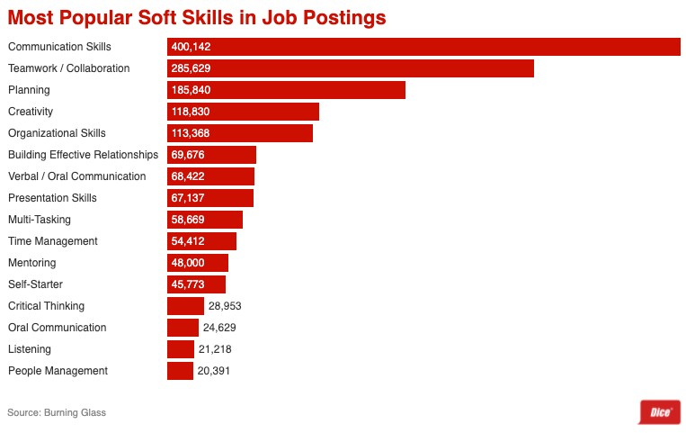
Current/Future Skills Needs
According to the World Economic Forum, the top ten skills needed to thrive in the Fourth Industrial Revolution
Complex problem solving
Critical thinking
Creativity
People management
Coordinating with others
Emotional intelligence
Judgement and decision-making
Service orientation
Negotiation
Cognitive flexibility

Slide 13
What truly motivates us?
Mastery
Intrinsic Motivation
Purpose
Autonomy
Source: Drive: The Surprising Truth About what Motivates Us

Slide 14

i-school Threads
Work study, apprenticeships, community engagement camps/workshops
Wildcat Manufacturing: Work-based, Student Led Enterprise FIRST Robotics, competitions (drone racing (air-land-sea) /battle-bots/?
Innovation & Entrepreneurship
Agile/Lean Engineering and Advanced Manufacturing, Automotive, Aerospace, …
Academic
Disciplines
English
Math
Physics
History
Arts
CTE
Electives

Slide 15
i-school Threads
Work study, apprenticeships, community engagement camps/workshops
Wildcat Manufacturing: Work-based, Student Led Enterprise FIRST Robotics, competitions (drone racing (air-land-sea) /battle-bots/?
Innovation & Entrepreneurship
Agile/Lean Engineering and Advanced Manufacturing, Automotive, Aerospace, …
Digital Design &
Digital Design
Digital Design &
Digital Design &
DE/AP Robotics,
Wildcat
i-School Courses
Manufacturing 1
Manufacturing 2
Manufacturing 2
Manufacturing 2,3
Adv Mfg Design &
Manufacturing
Intro to CAE/CAD/CAM
For Wood*
9-12
For Composites*
For Metals*
9-12
Automation** Fall/Spring 11-12
Student Led business***
9-12
9-12
Fall/Spring 11-12
**DDM1, DDM2,
**DDM1, DDM2, instructor
Prerequisites:
*DDM1 + instructor recommendation
or eqiv. & instructor recommendation
recommendation, & application

Slide 16
i-school Threads
Work study, apprenticeships, community engagement camps/workshops
Wildcat Manufacturing: Work-based, Student Led Enterprise FIRST Robotics, competitions (drone racing (air-land-sea) /battle-bots/?
Innovation & Entrepreneurship
Agile/Lean Engineering and Advanced Manufacturing, Automotive, Aerospace, …
i-School Skills/ Disciplines
CAE/CAD/CAM
Set-Based
Wicked Problem Solving
Generative
Design
Lean
Startup &
Hybrid
Scrum
Concurrent
Manufacturing
Engineering
AI/ML Analytics
Design Thinking
Automation

Slide 17

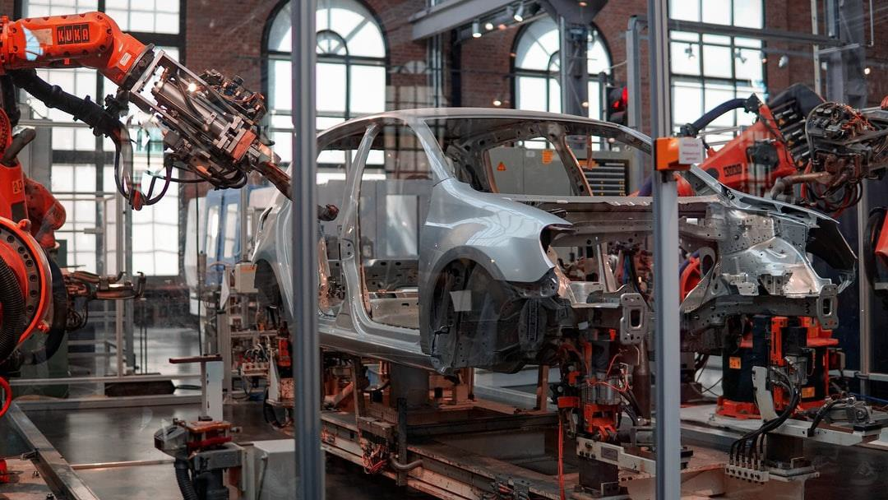
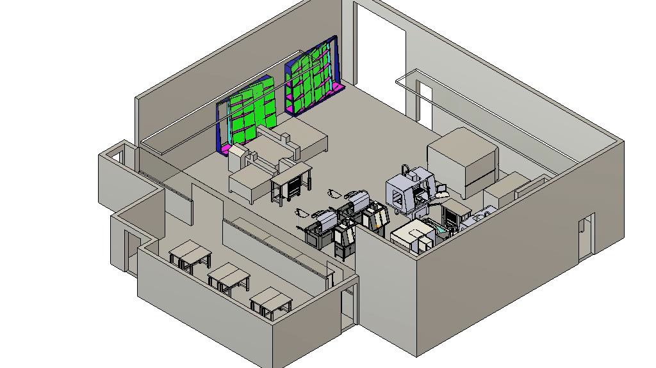
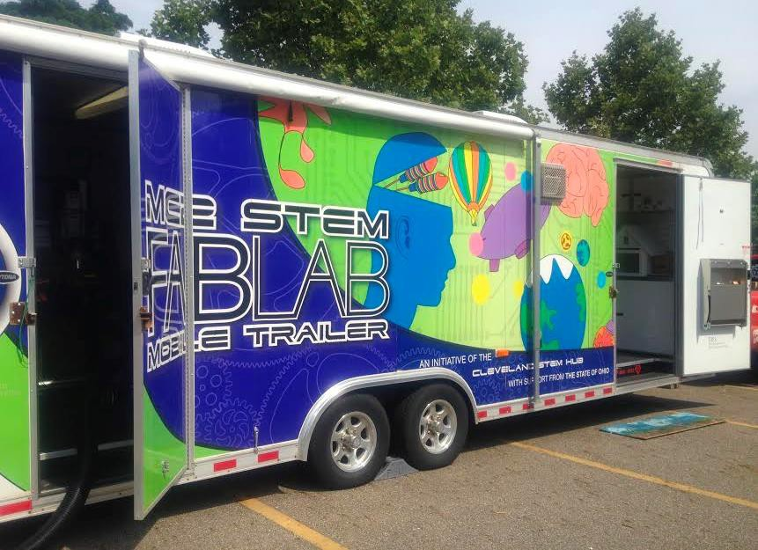
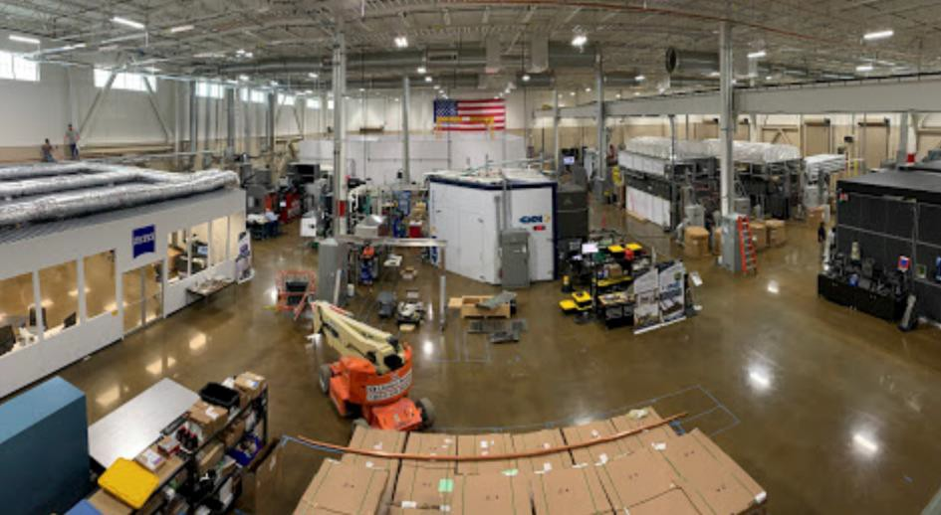
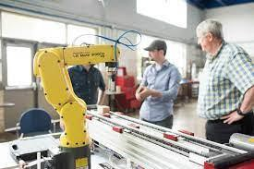
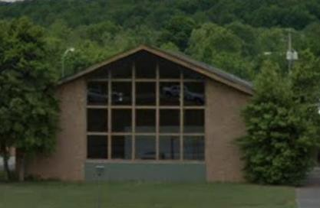
Reimagining Space
i-School Design and Manufacturing Center (DMC)
RSCC – New Mechatronics Manufacturing Lab
Mobile i-Labs for remote workshops/trainings
UTK, Manufacturing Demonstration Facility, &
IACMI
Innovation Station (revitalized and transformed Armory by the community)
  i-Stage: to celebrate creativity, innovation, and
learning with the community
  Ignite showcases
  i-Zones: Mini themed i-Labs (3D printing, Making, AV production, Autonomous & unmanned vehicles lab)
  Mobile i-Lab remote workshops/trainings
Innovation Station
i-school

Slide 18
Course Sequence
Other CCTE Academies
i-School NIC STEM IIA: Digital Design Manufacturing
For Wood* 9-12
i-School DE Advanced STEM Wildcat Manufacturing
Student Led business*** Fall/Spring
11-12
i-School NIC STEM I: Digital Design & Manufacturing 1
9-12
i-School NIC STEM II: Digital Design & Manufacturing
For Composites*
9-12
i-School DE/AP Advanced STEM Robotics** Fall/Spring
11-12
i-School NIC STEM II: Digital Design & Manufacturing 2,3 For Metals*
9-12
i-school

Slide 19





Reimagining Time
Block scheduling will allow more students to
explore offerings
  Extended hours access to i-School DMC
    Mornings
    Lunch block
    Study Hall
    After school
After school
  FIRST Robotics, drone clubs, i-camps, …
Summer i-Camps/workshops
Virtual & remote curricula/training options

Slide 20
Reimagining Modes of Learning
Experiential learning, complex real- world problems/projects requiring critical thinking & working with others
  Building Robots designed for epic battles, Building and racing drones, Building robots and competing in FRC, Student initiated problems/projects
  Wicked Problem Solving
  Agile Learning/Scrum Teams
  Innovation and Entrepreneurship: Lean
Startup, Design Thinking
Virtual Leveraging
  Kahn Academy, Google Learn, Astra Nova, Autodesk Academy, Titans or CNC Academy, JIT curated content
The leadership, learning team, faculty,
& councilors will operate using
Scrum@Scale and the i-School way
Deliberate practice, self-quizzing
Reflection: continuously assess
learner’s engagement & progress
Every year everything we do and how we are doing it will be re-evaluated & changed applying the lessons learned from each project, simulation, workshop, assessment, survey, and discussion to improve the next cycle of learning.

Slide 21

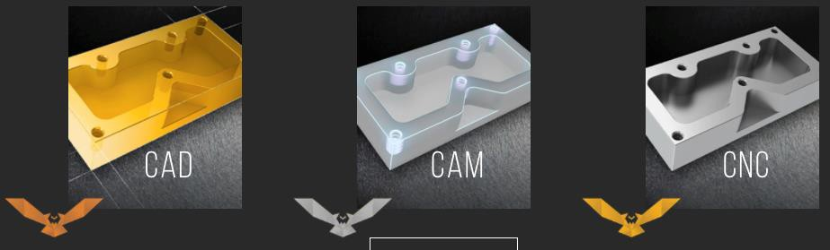
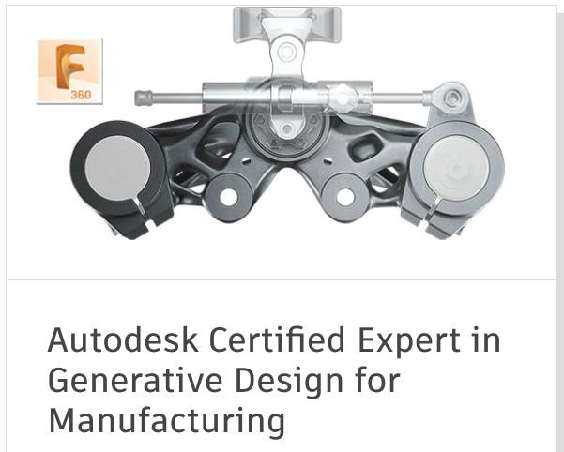
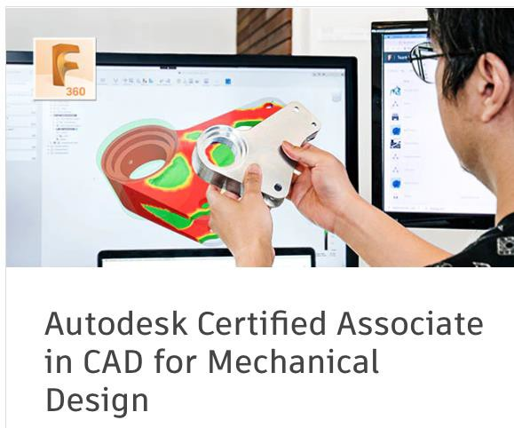

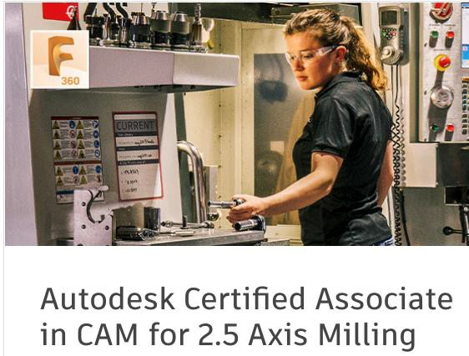
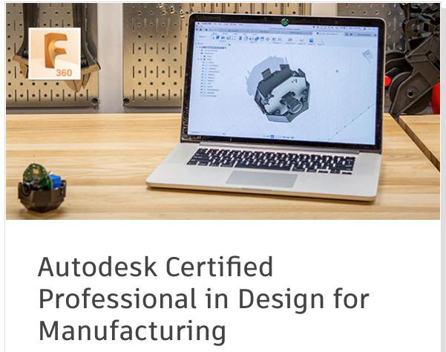
Credentials
Registered Scrum Master, Registered Scrum Product Owner, Scrum@Scale Practitioner for students, faculty, staff and counselors/advisors
Autodesk/Fusion360 Credentials
ACE/SEAMTN
Titan’s of CNC Academy
Certificates from SACA.org
Siemens Industry 4.0 certifications and
Industrial Internet of Things (IIoT)
PMMI Association for Packaging and
Processing technologies
certificates https://www.pmmi.org/

Slide 22











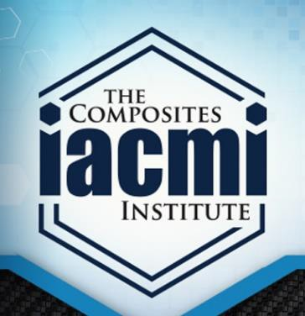
Reimaging Partnerships
ORHS, Middle & Elementary Schools
  “i-School way” Training/workshops for educators, councilors, leadership
RSCC, PSCC
  Certificates, Middle College AS degrees
    Agile Engineering Advanced Manufacturing
    Business Innovation and Entrepreneurship
  Mobile/Portable i-labs for workshops, trainings
UTK ACE/SEAMTN, Manufacturing Demonstration Facility & IACMI
  Course alignment for UTK degree
ORT-E, TTE, Lokar, Others?
  Course/workforce skills needs, product/project ideas,
apprenticeships
i-School Design and Manufacturing Center
  Wildcat Manufacturing
  Work apprenticeships
  Product Development Manufacturing and Sales

Slide 23

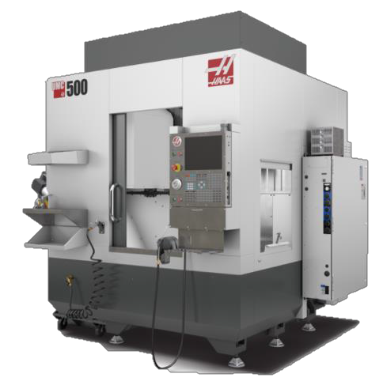
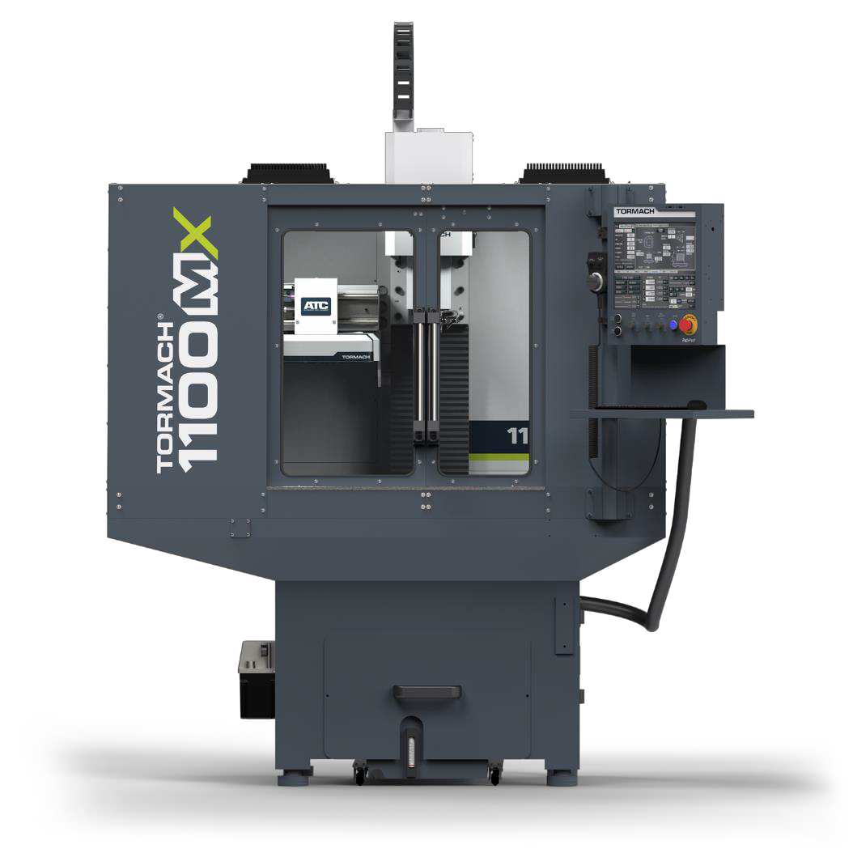
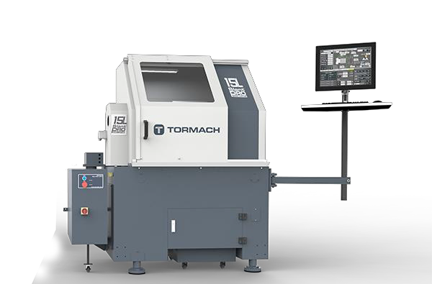
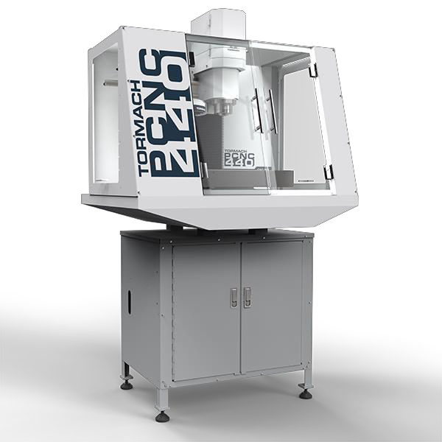
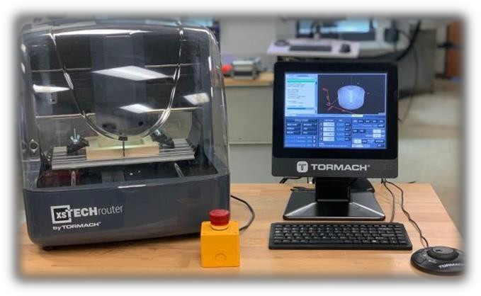
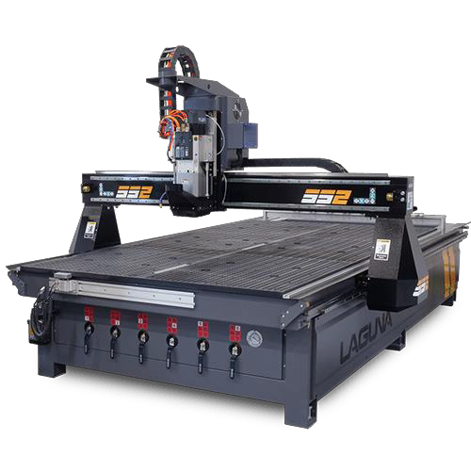
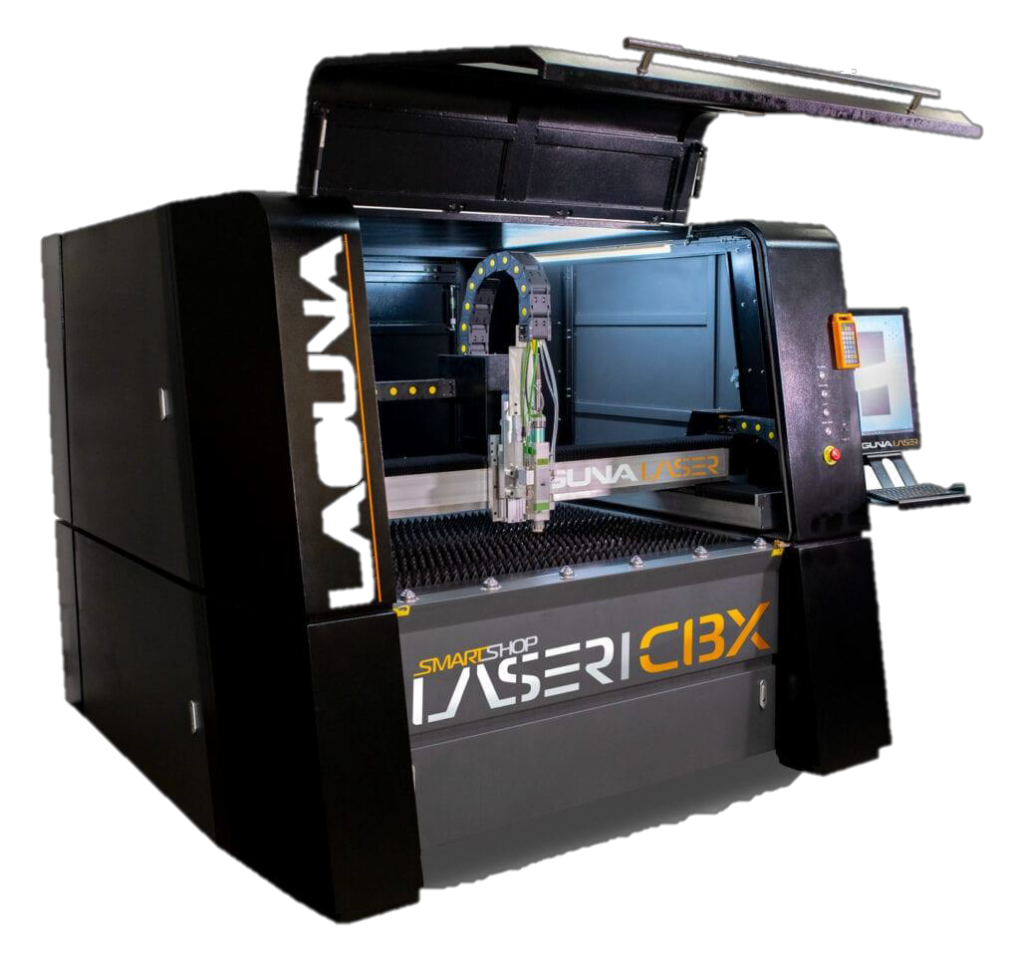
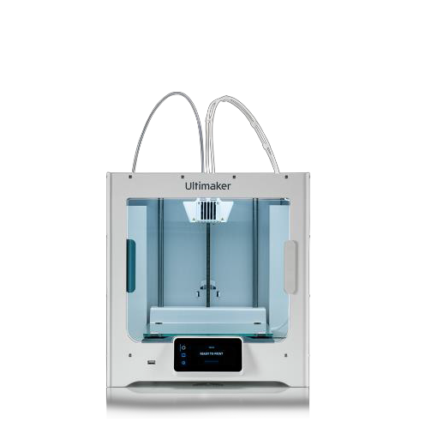
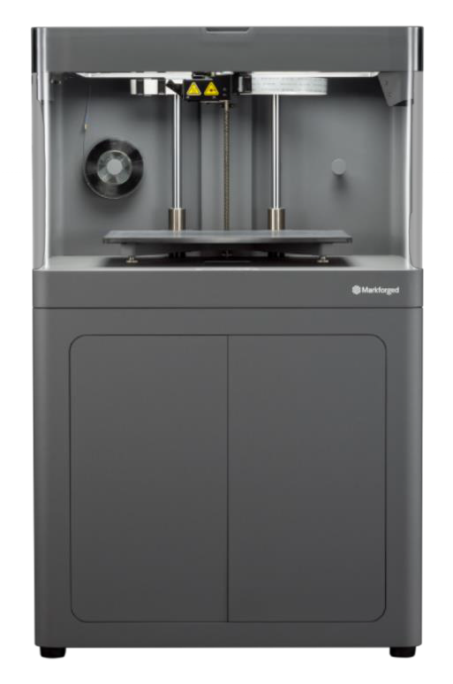
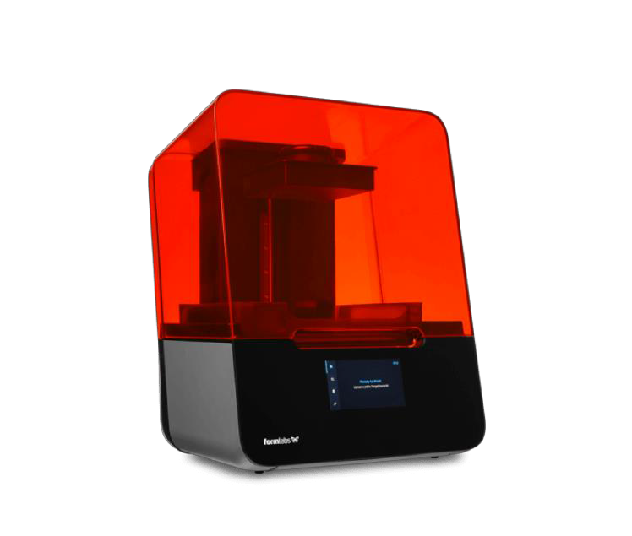
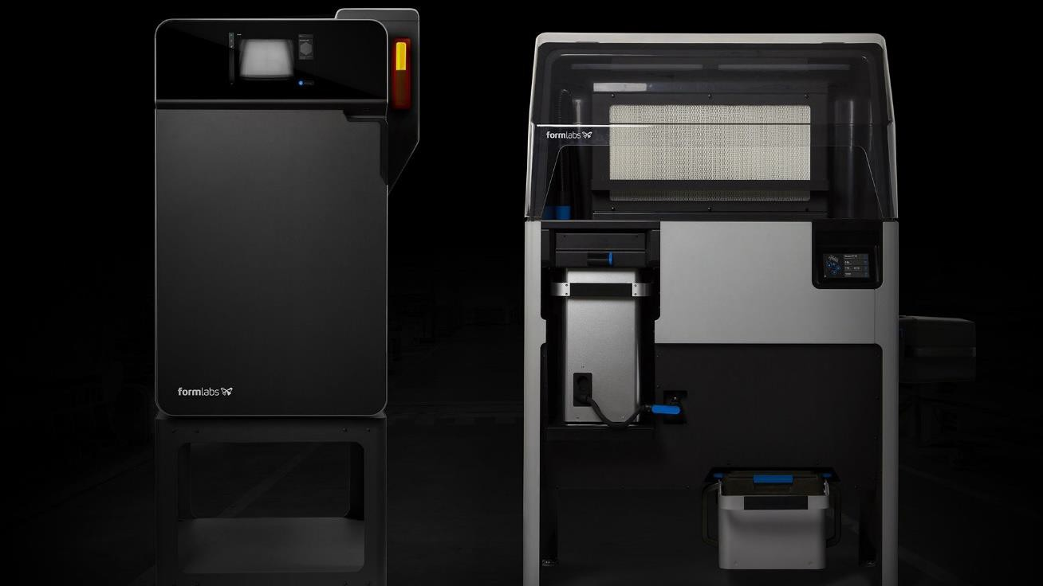
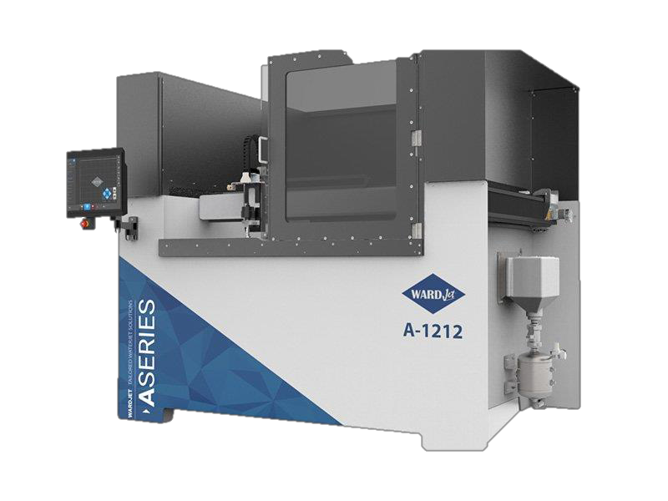
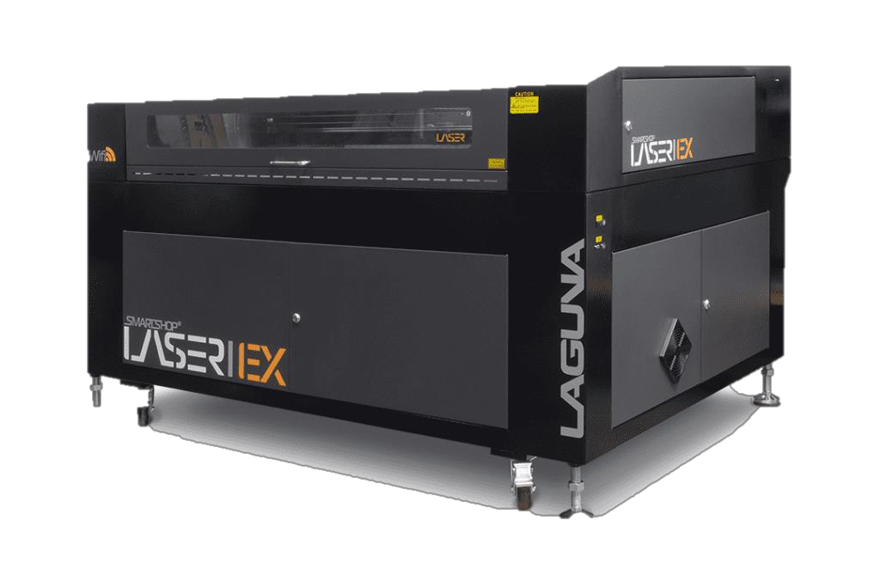
Equipment
i-school

Slide 24

Questions?

Slide 25




Thank you!
i-School
An Innovation Learning Ecosystem
empowering the InnovatORS of tomorrow today!
innovation, individualized, inclusion, interpersonal, integrative-thinking, interdisciplinary, always improving and internal motivation

Slide 26
Committee Discussion: What are your “Walls”?
Community Partners (Industry/Business): What are the barriers to your work?
Community Partners (Post-Secondary): What are the barriers to your work?
PreK-12 Educators: What are the barriers to your work pertaining to STEM Education?

Slide 27
School STEM Share-Out
Do the schools have any upcoming STEM needs that community partners and/or parents can assist with?

Slide 28
Community Partner Share-Out
Do our community partners have any information or events that need to be shared with ORS staff and/or students?
Can ORS support our community partners in any upcoming endeavors?

Slide 29
Next meeting is Monday, April 11
Agenda and Team link to be emailed in early April

